Slide 1
IBM ACCOUNT OPENS
Team Id | PNT2022TMID36462
Project name | Traffic and Capacity analytics for major ports
SARATHKUMAR.P | TEAMLEADER
MOHAN.K | MEMBER1
KARTHICK.M | MEMBER2
YOGESH.G | MEMBER3
SAVITHRI.B | MEMBER4
Step:1- Open IBM account
Step:2- Click on Prepare the data

Slide 2
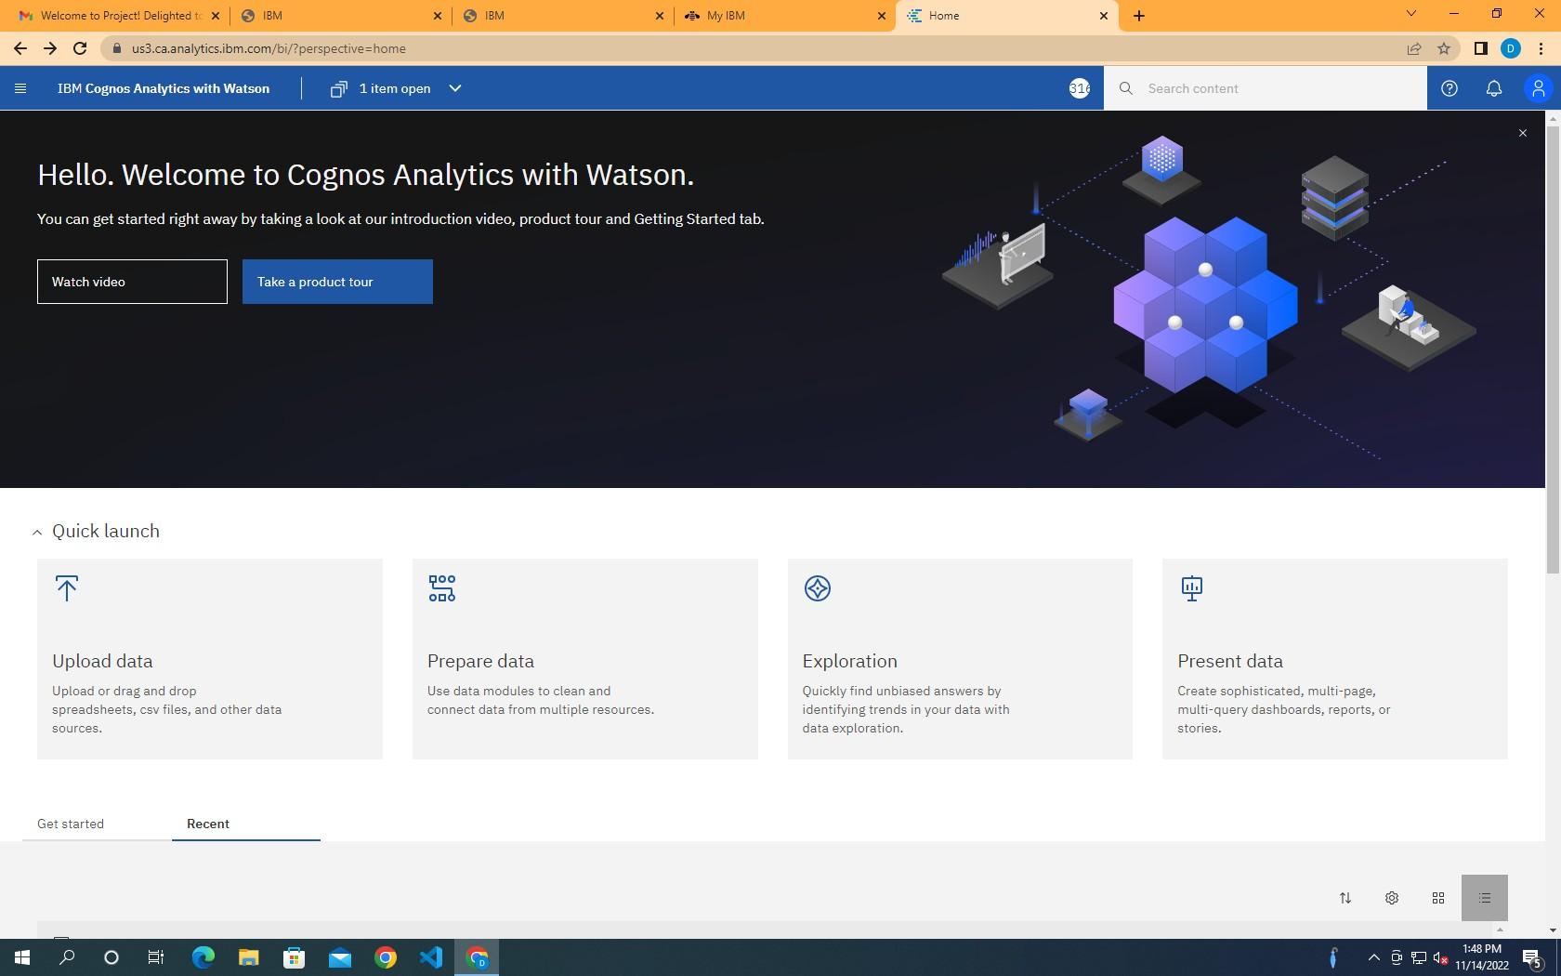
STEP:3

Slide 3
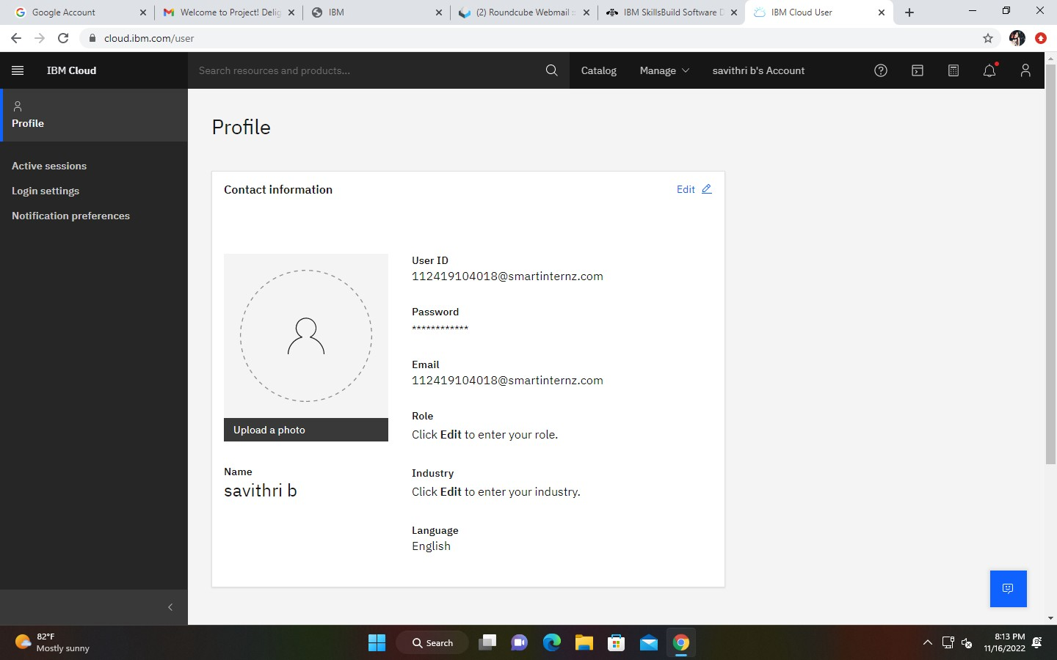
Step:4

Slide 4
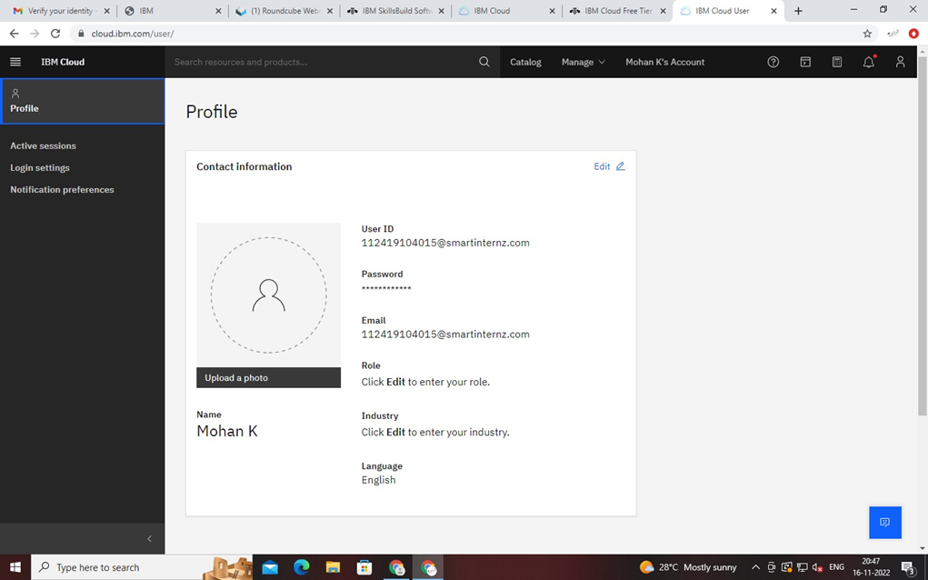
STEP:5

Slide 5
STEP:6 stop

